Slide 1
R11i & R12 Supply Chain Cost Rollup, What Works, What Doesn't?
Sue Doughty
Group Business Analysis / Cost
Emerson Network Power Systems North America
Douglas Volz
Douglas Volz Consulting Helping people use Oracle Applications since 1990
doug@volzconsulting.com

Slide 2
Learning Points
Learn how the cost rollup works
Understand the differences between rolling up with and without supply chain sourcing rules (assignment sets)
Roll up costing for resources, resource (production overheads) and outside processing
Review available error-checking reports for common cost rollup and item costing setup errors

Slide 3
Agenda
Cost Rollup And Item Cost Review
Rollup and Rollup Cost Overview
BOM Parameter Setup
Define Departments and Overheads
Define BOMs
Define Routings and Standard Operations
Supply Chain / Sourcing Rules Setup
Make Item Costing
Item Master and Cost Control Error Checking
Notes:
Primary focus is average and standard costing
Interfaces will not be reviewed, unless for pending or uncosted transactions
Module names will not be discussed

Slide 4
Item Costing Setup Overview
Sub-Element Defaults
Org Setup
Sub-Elements
Cost Mass Edits
Cost Types
Item Costing
Cost Rollup

Slide 5
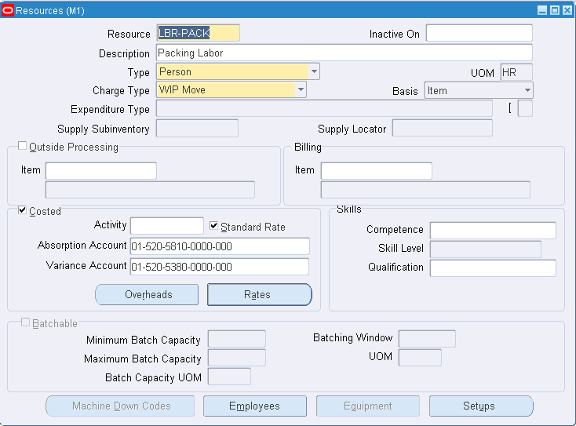
Cost Setup - Subelements (Refresher)
Menu path: Cost Management => Setup => Sub-Elements => Resources
Resources
To directly earn resources at standard use Autocharge Type “WIP Move”
Resources can be costed or not costed. Not costed resources are used for scheduling

Slide 6
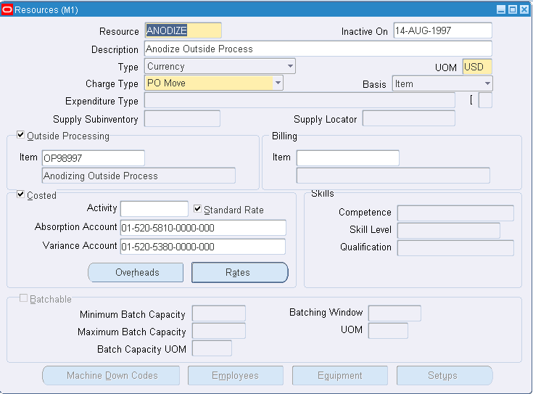
Cost Setup - Subelements (Refresher)
Menu path: Cost Management => Setup => Sub-Elements => Resources
OSP Resources
Standard Rate is checked - WIP jobs will be charged at std unit cost

Slide 7
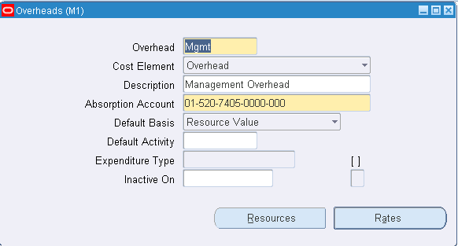
Subelements (Continued)
Menu path: Cost Management => Setup => Sub-Elements => Overheads
Production Overhead Rates – for the Cost Rollup
Same form sets up material overheads and departmental overheads

Slide 8
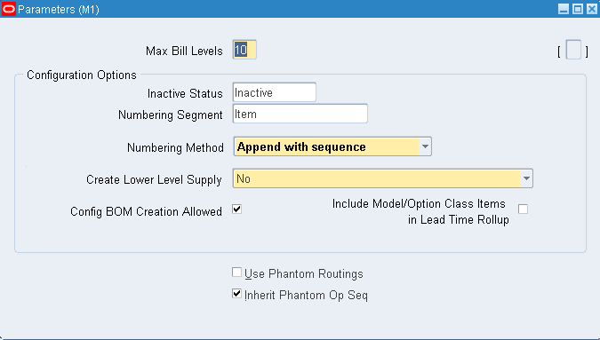
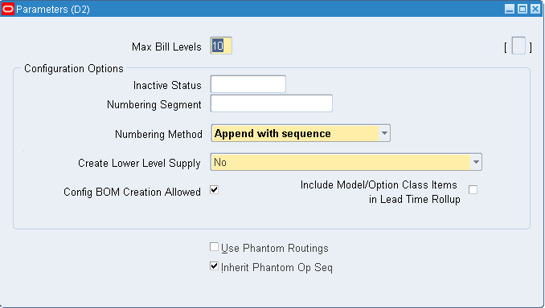
BOM Parameters (BOM Responsibility)
Menu path: Bills of Material => Setup => Parameters
BOM parameters need to be defined in order to run the Supply Chain Cost Rollup – including the Distribution Orgs

Slide 9
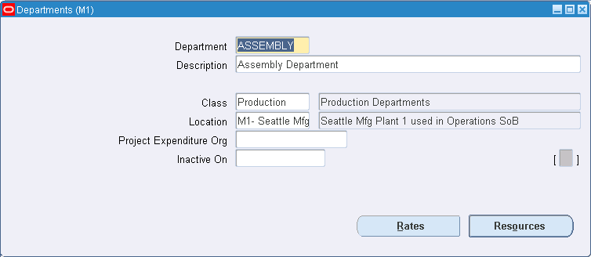
Define Departments (BOM Responsibility)
Menu path: Bills of Material => Routings => Departments

Slide 10
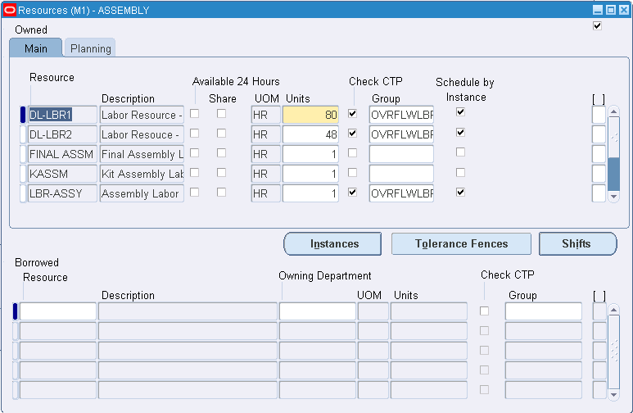
Assign Resources to Departments (BOM Responsibility)
Menu path: Bills of Material => Routings => Departments Form => Resources Button
Enables the valid resources for each department

Slide 11
Define Departments (BOM Responsibility)
Menu path: Bills of Material => Routings => Departments

Slide 12
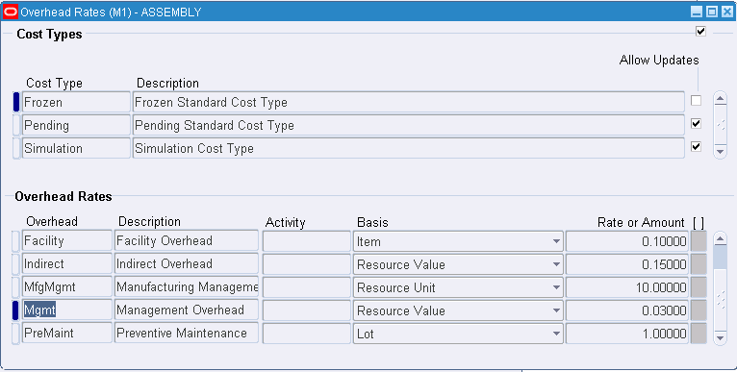
Assign Dept Ovhd Rates (BOM or Cost Responsibility)
Menu path: Bills of Material => Routings => Departments Form => Rates Button
Menu path: Cost Management => Setup => Sub-Elements => Overheads
Sets up which overheads can be earned in each department

Slide 13
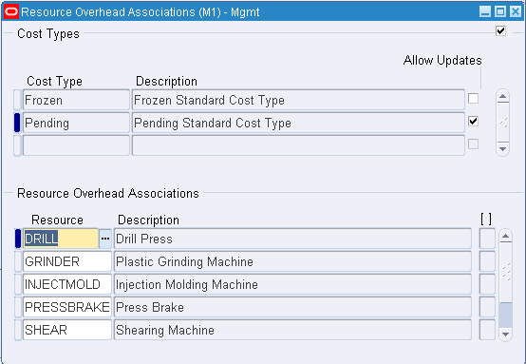
Assign Overheads to Resources (Cost Responsibility)
Menu path: Cost Management => Setup => Sub-Elements => Overheads => Resources Button
Menu path: Cost Management => Setup => Sub-Elements => Resources => Overhead Button
Sets up which overheads can be earned by which resources

Slide 14
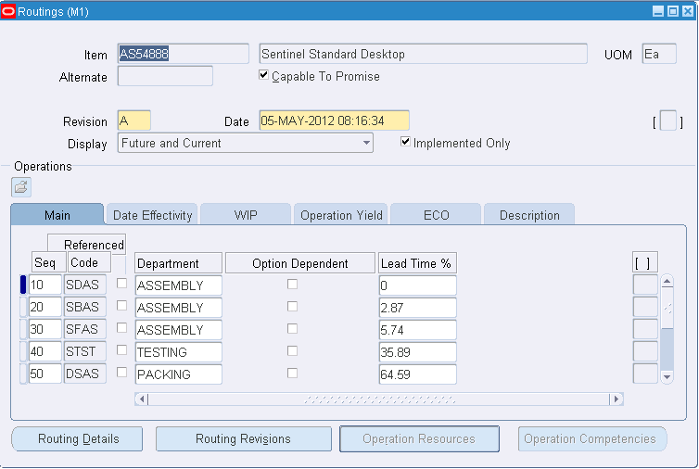
Define Routings (BOM Responsibility)
Menu path: Bills of Material => Routings => Routings
Use standard ops to save time – automatically assigns resources to each operation

Slide 15
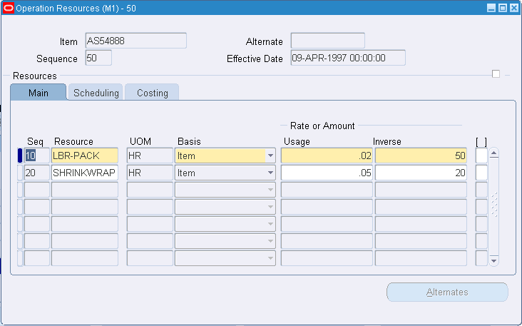
Define Routings (BOM Responsibility)
Menu path: Bills of Material => Routings => Routings => Operation Resources Button
Depending on your “Reference” setting you can set the usage based on the standard operation or override it on each routing

Slide 16
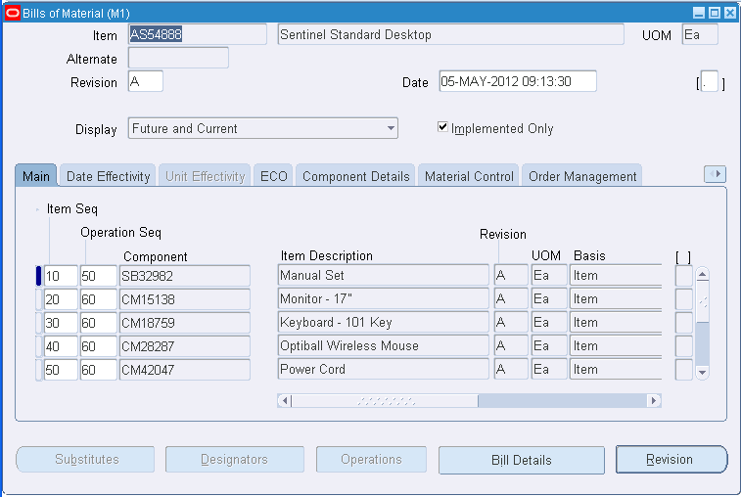
Define Bills of Material (BOM Responsibility)
Menu path: Bills of Material => Bills

Slide 17
Cost Rollup Three-Way Association
Relationships Across BOM Departments, Resources and Overheads
Resources associated with Overheads
By Cost type
Resources and
Overheads
BOM Departmental Resources
Departments Linked to Overheads
By Cost type
Department and
Overhead
Resource
Department
BOM Departments
Inventory Org
Department Code
Best practice: have Cost Accounting Approval for new departments and resources

Slide 18
Cost Rollup – Overall Process

Slide 19
Supply Chain Cost Rollup
If you use Sourcing Rules
Creates a snapshot of the Sourcing Rules/Bills of Distribution.
Explodes the BOM for each assembly in the supply chain.
Explosion logic considers sourcing rules captured in the snapshot and tracks the item and organization combinations
Items from multiple sources in the supply chain are merged.
Costs from different sources such as make, buy, and transfer items are merged to the rolled up cost in the destination org.
Weights are used from the sourcing snapshot.
The costs transferred from other organizations are considered previous level costs, and their elemental visibility is preserved. The buy costs are summed into this level of material cost.
You can save the details of the buy item costs by selecting Yes in the Preserve Buy Cost Details parameter.

Slide 20
Supply Chain Cost Rollup (continued)
Additional notes:
Additional markup costs are applied to item costs transferred from other organizations (per the Shipping Networks)
For additional markup costs, for the destination organization, there must be a value for the Default Material Overhead Sub-Element field from the Inventory Organization Parameters
Use of sourcing rule percentage allocations can complicate your costing and give rise to a “blended cost”
Note: Sub-element details from source organizations is not transferred over to the destination organization

Slide 21
Supply Chain Cost Rollup (continued)
For all Cost Rollups:
User defined costs for the top level assembly are not recalculated during the Supply Chain Rollup program
Common Custom Cost Rollup Reports for:
List of sourcing rules
Comparison of “Make/Buy” with “Based on Rollup” cost controls
Summary analysis for which Inventory Orgs to Roll-Up
Do Item Costs exist?
Do BOMs exist?
Do Routings exist?
Do Sourcing Rules exist?

Slide 22
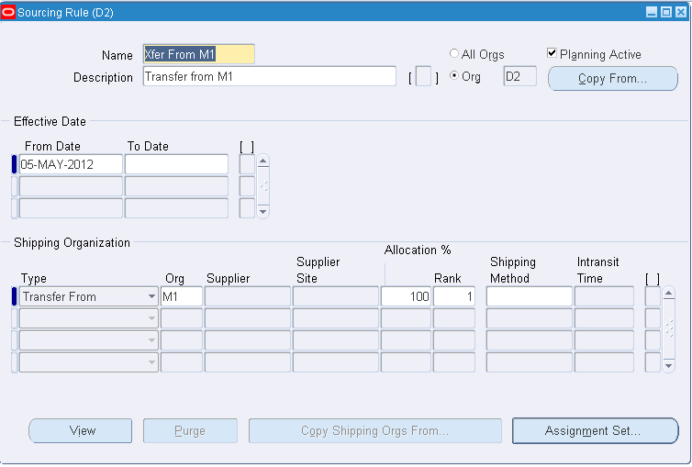
Sourcing Rules – Cost Rollup Across Orgs
Menu path: Cost Management => Supply Chain Costing => Define Sourcing Rules

Slide 23
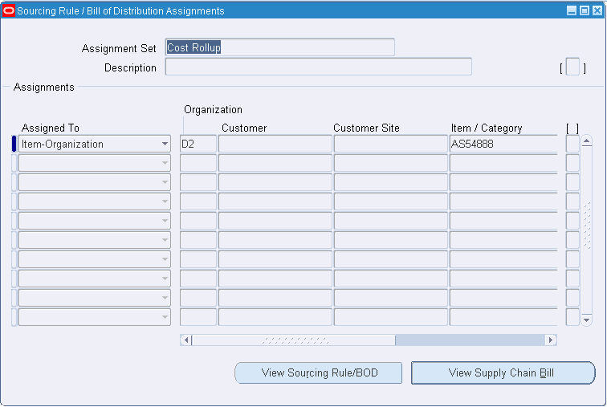
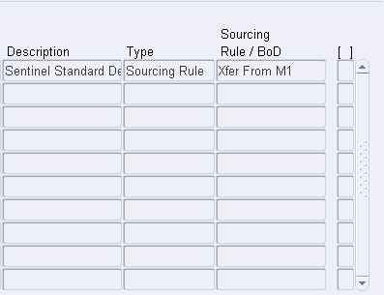
Sourcing Rule Assignments - Cost Rollup Across Orgs
Menu path: Cost Management => Supply Chain Costing => Define Sourcing Rules => Assignment Set Button
Recommendation: write a custom report to see your sourcing rules

Slide 24
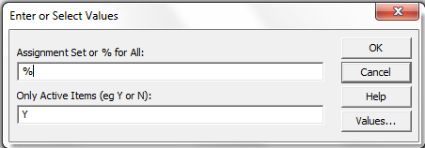
Sample Custom Sourcing Rule Report
Much easier to read this report (than the Oracle screens)

Slide 25
Sourcing Rules – Structural Relationships
Sourcing Rules
Sourcing Rule Name
Status
Inventory Organization (can be NULL)
Sourcing Assignment Sets
Assignment Set Name
Sourcing Rules Assignments
From Org Sourcing Rules (Source Org)
From Org Sourcing Rule
To Org Sourcing Rule
Source Organization
Vendor and Vendor Site
Source Type (Org, Vendor)
Allocation Percent
Assignment Set Name
Assignment Type (ORG)
Source Inventory Org
Sourcing Rule
Item Number
Item Master
Inventory Org
Item Number
To Org Sourcing Rules (Receipt Org)
To Org Sourcing Rule
To Org Inventory Organization (can be NULL)

Slide 26
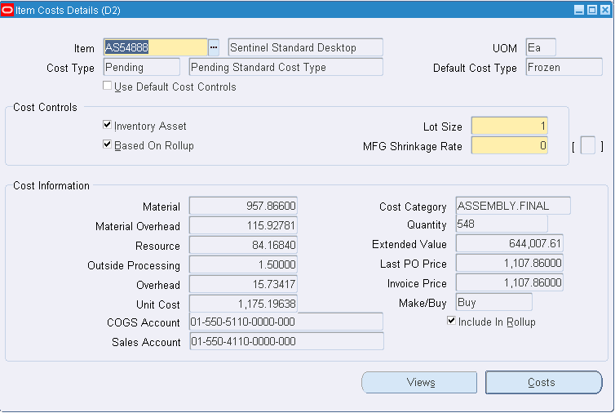
Make / Buy vs. Based on Rollup Controls
Menu path: Cost Management => Item Costs => Item Costs

Slide 27
Make / Buy vs. Based on Rollup Controls
Planning Make / Buy
Planning controls are separate from Costing
“Make” - Usually Based on Rollup is checked (Yes)
To avoid rolling up an item uncheck Based on Rollup (No)
“Buy” - Usually Based on Rollup is not checked (No)
But, to use Sourcing Rules from the Assignment Set you must check Based on Rollup (Yes), even for “Buy” items

Slide 28
Supply Chain Cost Rollup – No Assignment Sets

Slide 29
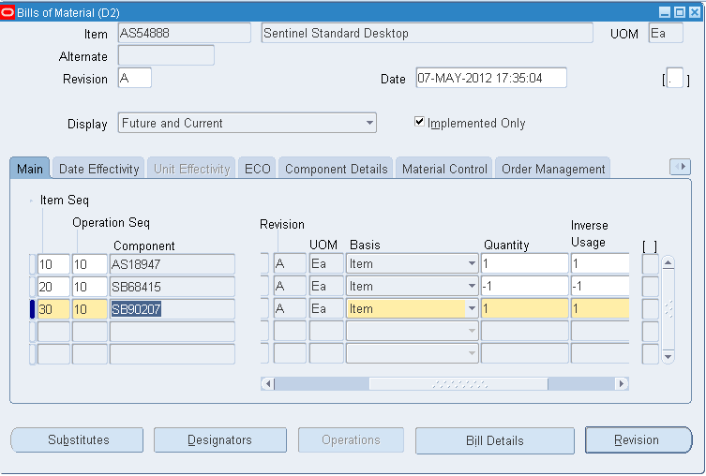
Cost Rollup Bill – Rework Bill
Menu path: Bills of Material => Bills
Org D2: Create standard desktop unit by exchanging the chassis with the deluxe unit

Slide 30
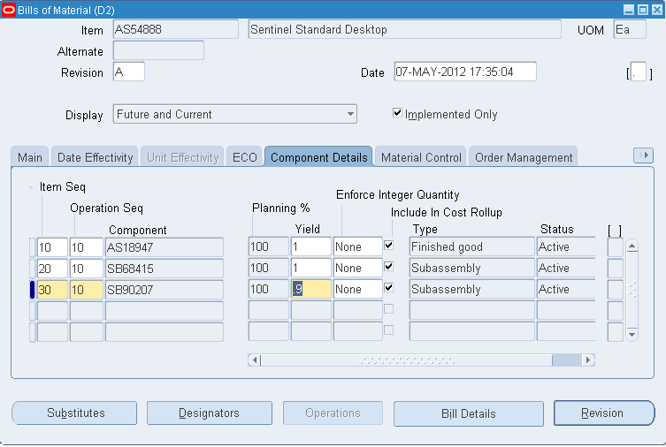
Cost Rollup Bill – With Component Yield
Menu path: Bills of Material => Bills => Component Details Tab
Org D2: For every ten reworked desktop units, one replacement chassis is lost

Slide 31
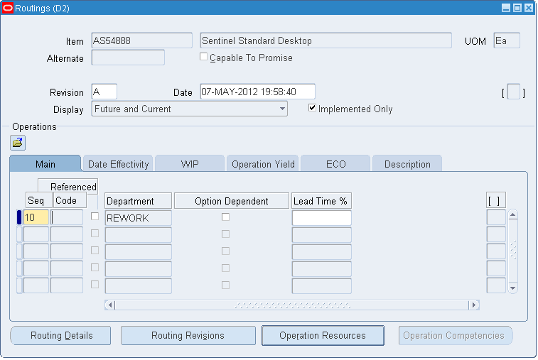
Cost Rollup Routing – No Assignment Sets
Menu path: Bills of Material => Routings => Routings
Org D2: If not available from M1, rework a deluxe desktop to make a standard one

Slide 32
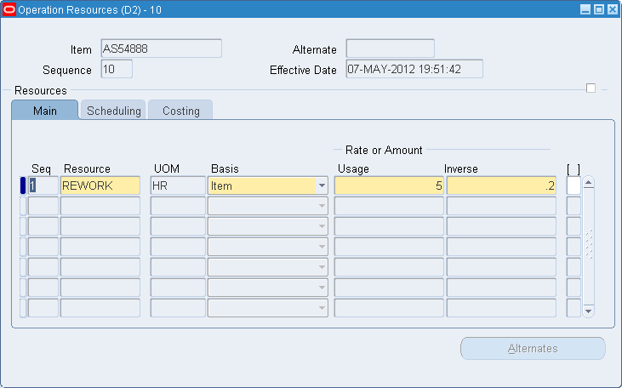
Cost Rollup Routing – No Assignment Sets
Menu path: Bills of Material => Routings => Routings => Button Operation Resources
Org D2: Each reworked Desktop unit takes 5 hours

Slide 33
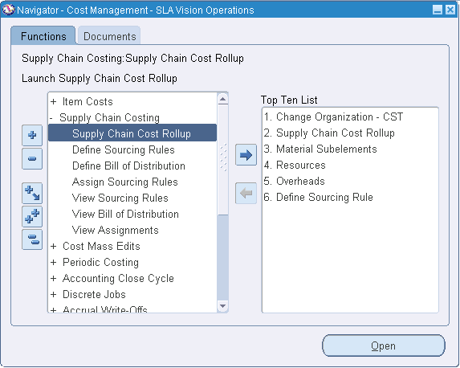
Supply Chain Cost Rollup – No Assignment Sets

Slide 34
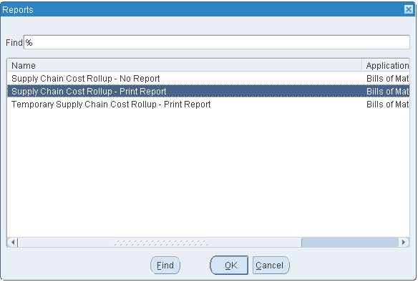
Cost Rollup Choices
Supply Chain Cost Rollup – No Report: rolls up costs, changes Pending, but no report
Supply Chain Cost Rollup – Print Report: rolls up costs, changes Pending and creates report
Temporary Supply Chain Cost Rollup – Print Report: rolls up costs, only produces a report

Slide 35
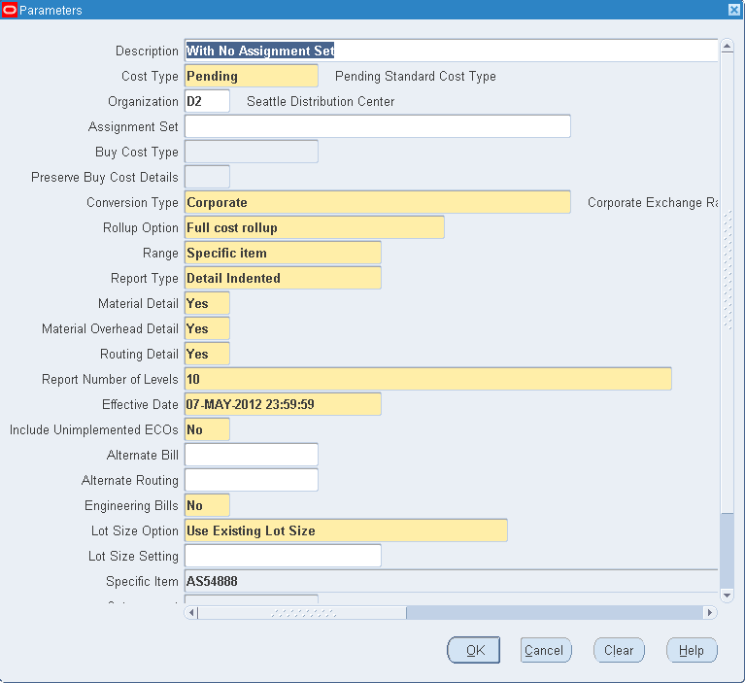
Cost Rollup Parameters – Within the Org
Rollup Options:
Single level – Goes down one level and rolls up costs
Full cost rollup – Fully explodes the BOM

Slide 36
Cost Rollup Concurrent Submission
Two Concurrent Jobs are Submitted When You Run the Cost Rollup with Report:
But only one job when you run Temporary Report:

Slide 37
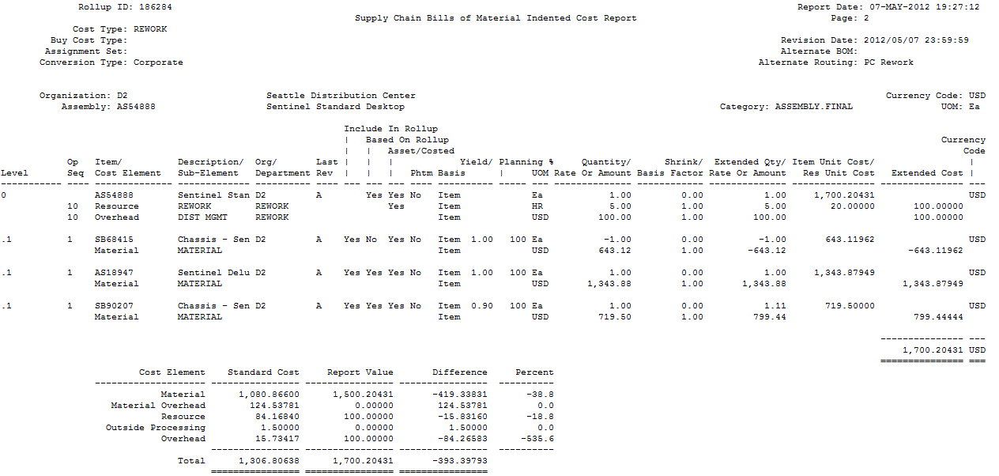
Indented Bill of Material Cost Report
Rolled Up Costs
Current Frozen Costs
As Reported Costs

Slide 38
Indented Bill of Material Cost Report - Parameters
Cost Type and other parameters
Effective date used
The Org and Item you are rolling up
Alternate BOM or Routing
Operation Sequence from the routing
Level 0 is the Top Level, each level after this “indents”
Composite report, with two headings, top heading for Item Numbers, bottom heading for Sub-Elements on a routing (or manually defined costs)

Slide 39
Indented BOM Cost Report – Item Information
Item Cost Controls
Assy Extended Qty
Assy Cost
Basis
Assy Shrink
Org
Rev
Item UOM
Item Number
Assy Qty
Operation Sequence from the routing
Component Qty
Item Cost
Component Yield
Component Extended Qty
Extended Cost
Level 0 is the Top Level, each level after this “indents”.
Level .1 is the first “previous level” for components and its resources

Slide 40
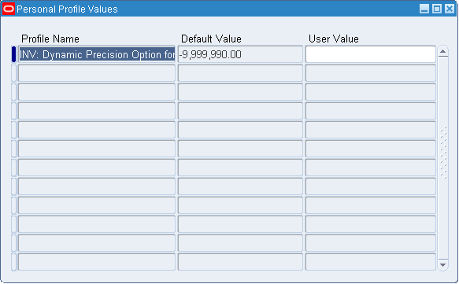
Indented BOM Cost Report – Report Profile
Menu path: Cost Management => Setup => Profiles => INV: Dynamic Precision Option for Quantity
This profile governs the Inventory, BOM, WIP and Costing report precision for quantities (not used on Purchasing Reports)

Slide 41
Indented BOM Cost Report – Resource Info.
Res Extended Cost
Basis
Res Basis Factor
Resource Unit Cost
Dept.
Rev
Cost Element
Resource Cost Controls
Res UOM
Rate or Amount per UOM
Extended Res Rate or Amount
Operation Sequence from the routing
REWORK Res: 5 hours X $20 = $100.00000
Level 0 is the Top Level, each level after this “indents”.
Level .1 is the first “previous level” for components and its resources

Slide 42
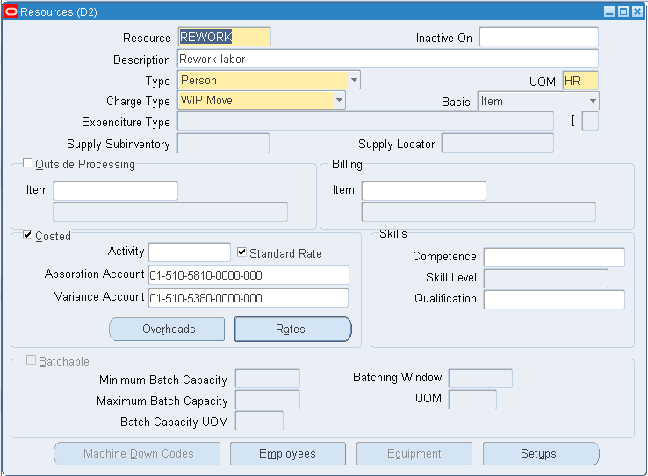
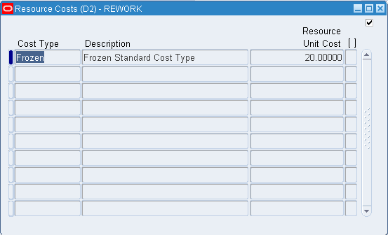
Indented BOM Cost Report – Resource Info.
Resource Usage on Routing X Rate = Extended Amount
5 X 20 = 100

Slide 43
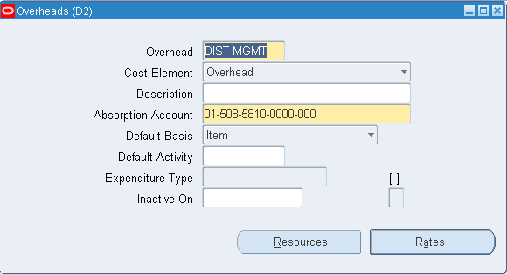
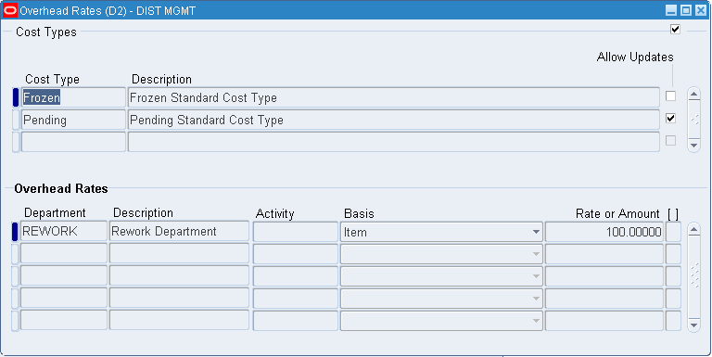
Indented BOM Cost Report – Overhead Info.
Overhead With “Item” basis
Overhead Usage X Rate = Extended Amount
1 X 100 = 100.00

Slide 44
Indented Bill of Material Cost Report - Summary
Assembly Rolled Up Costs
Current Frozen Costs
As Reported Costs
Difference

Slide 45
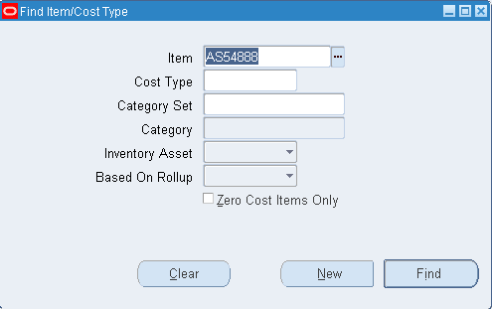
Cost Rollup – Item Cost Inquiry
Menu path: Cost Management => Item Costs => Item Costs
Look at a Make Item

Slide 46
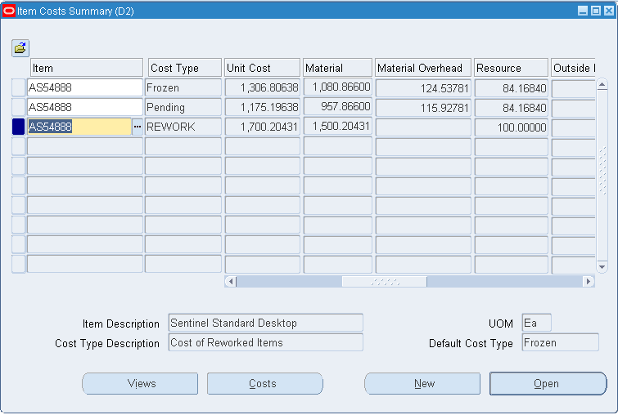
Item Cost Summary – Make Item
Menu path: Cost Management => Item Costs => Item Costs

Slide 47
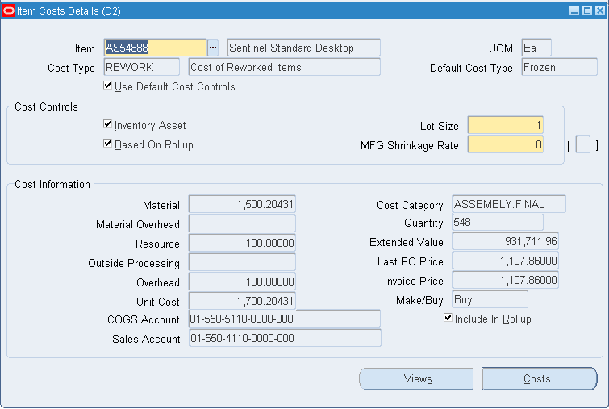
Item Cost Details – Make Item
Menu path: Cost Management => Item Costs => Item Costs => Open Button

Slide 48
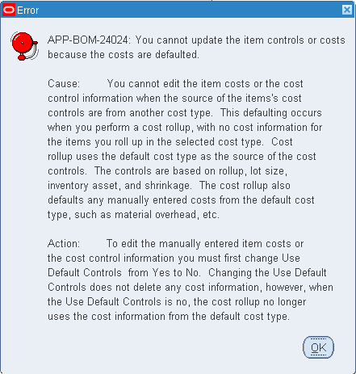
Can’t Directly Edit Rolled Up Costs
Turn Off Default Controls to:
Used by the Cost Rollup to get cost controls:
Based on rollup
Lot size
Shrinkage rate
Inventory asset
Turn off default controls to make changes to these controls
Turn off default controls to allow you to manually enter costs

Slide 49
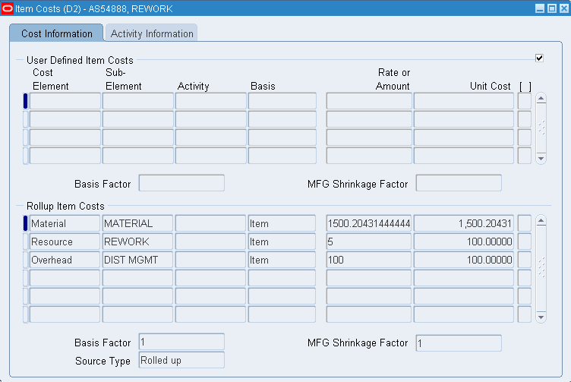
Cost Details for Make Items
Menu path: Cost Management => Item Costs => Item Costs => Costs Button
Regardless of your extended decimal precision settings you can still see more detail here

Slide 50
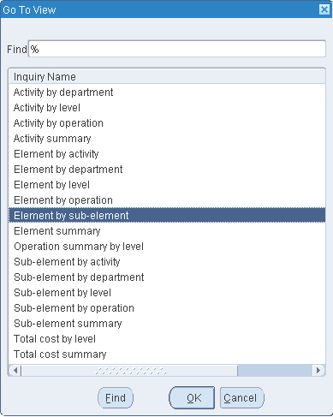
Cost Views for Make Item
Menu path: Cost Management => Item Costs => Item Costs => Views Button

Slide 51
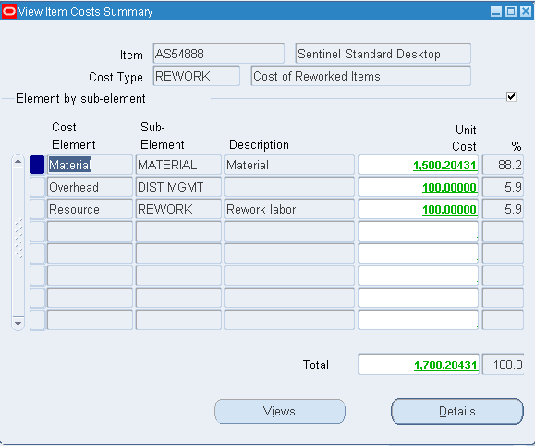
Element by Sub-Element Cost View
Menu path: Cost Management => Item Costs => Item Costs => Views Button
Click on the GREEN number to drill into its details

Slide 52
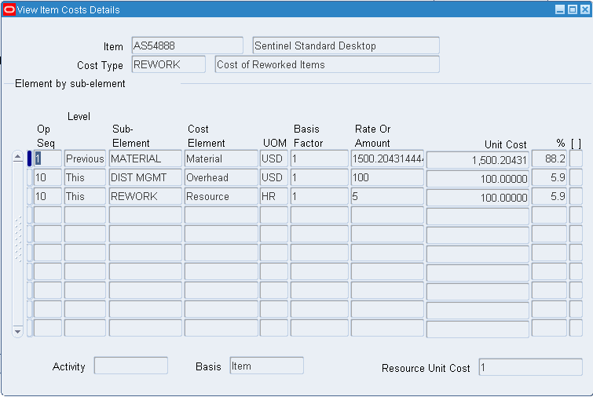
Item Cost Details – Make Item
Menu path: Cost Management => Item Costs => Item Costs => Views Button => Detail Button

Slide 53
Supply Chain Cost Rollup – With Assignment Sets

Slide 54
Supply Chain Cost Rollup – With Assignment Set
Caution: if you have significant number of bills/routings/levels or sourcing rules the Supply Chain Cost Rollup with Report can take an extended amount of time

Slide 55
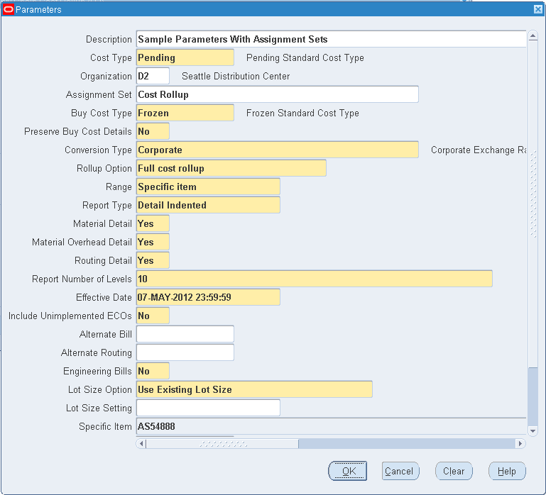
Cost Rollup Parameters – Across Supply Chain
With Assignment Sets
Uses sourcing rules to get costs from other inventory organizations
May dramatically change the assembly’s costs
Buy Cost Type
Allows you to use different costs for your buy items

Slide 56
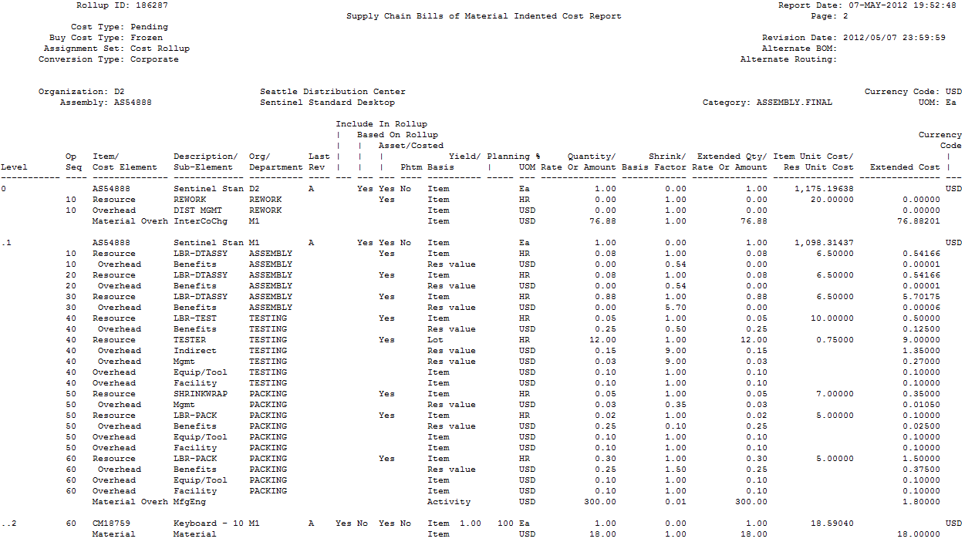
Indented Bill of Material Cost Report
Assignment Set is in the parameters
Rework Routing is not costed
Details from Source Org’s routings and BOMs are reported

Slide 57
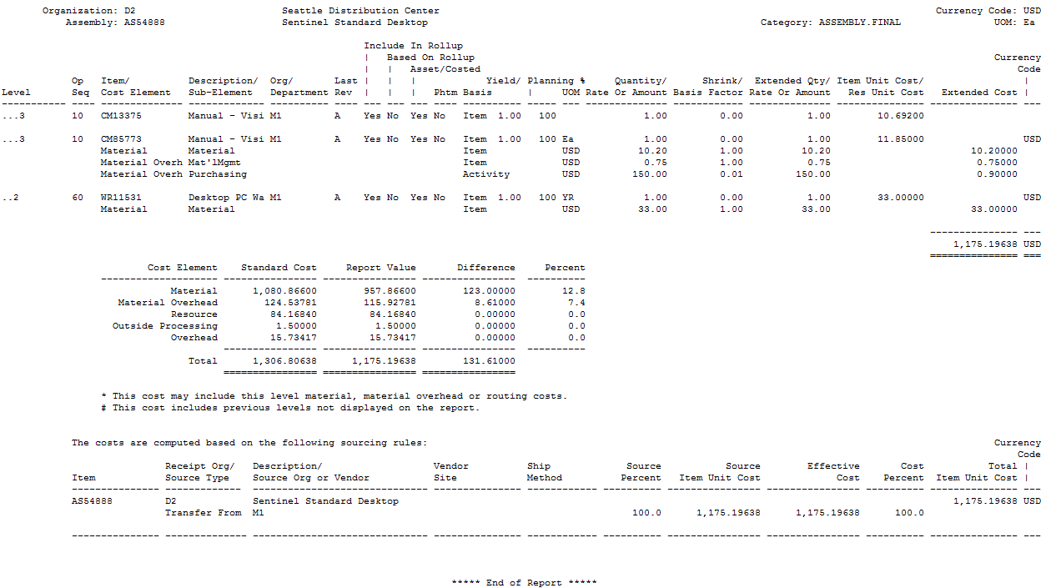
Indented BOM Cost Report – What Happened?
By using sourcing rules the cost rollup ignores the D2 Org bill of materials and routing, as it directly gets its costs from Org M1, item AS54888
Costs are from the sourcing rules

Slide 58
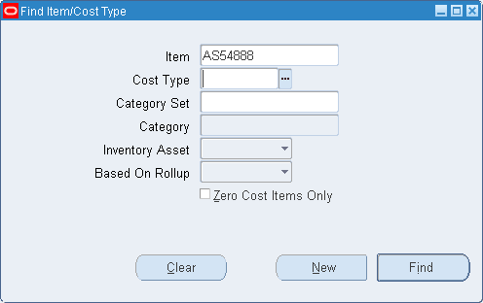
Cost Rollup – Item Cost Inquiry w/Assignment Set
Menu path: Cost Management => Item Costs => Item Costs
Look at a Make Item

Slide 59
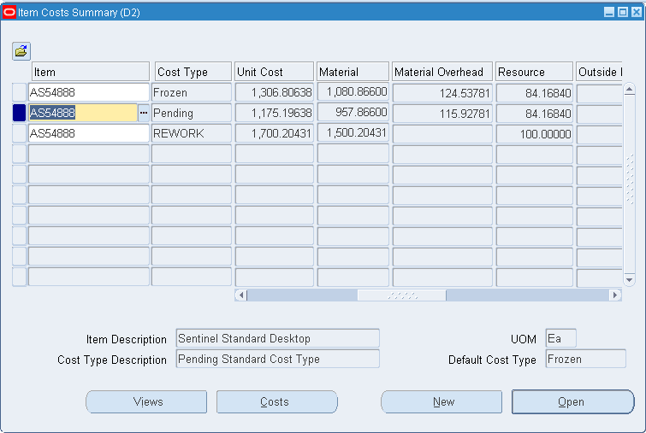
Item Cost Summary – Make Item
Menu path: Cost Management => Item Costs => Item Costs

Slide 60
Item Cost Summary – Make Item
Menu path: Cost Management => Item Costs => Item Costs => Open Button

Slide 61
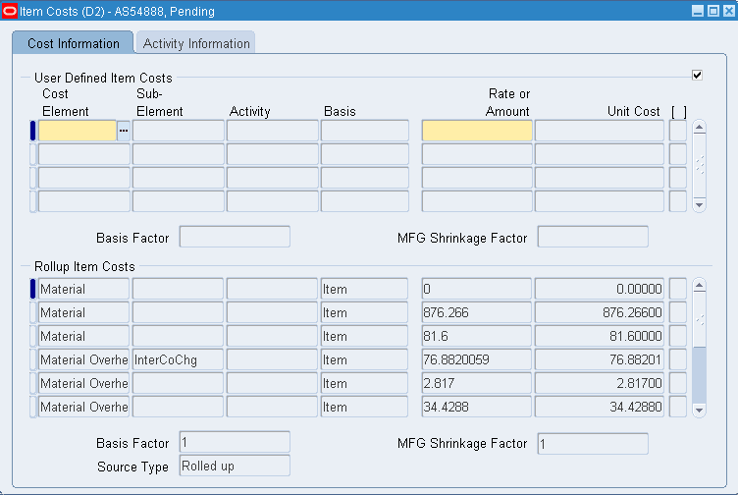
Cost Details for Make Items
Menu path: Cost Management => Item Costs => Item Costs => Costs Button
Costs now from the Sourcing Rules
Any D2 Org bill or routing costs roll up to zero

Slide 62
Cost Views for Make Item
Menu path: Cost Management => Item Costs => Item Costs => Views Button

Slide 63
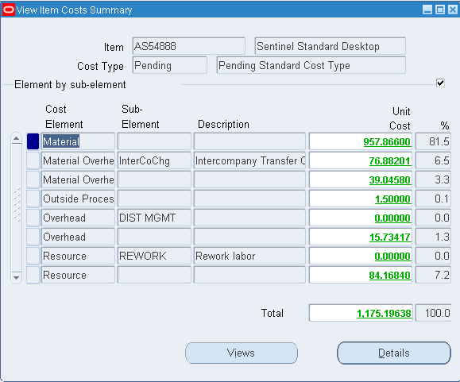
Element by Sub-Element Cost View
Menu path: Cost Management => Item Costs => Item Costs => Views Button => Details Button
Click on the GREEN number to drill into its details

Slide 64
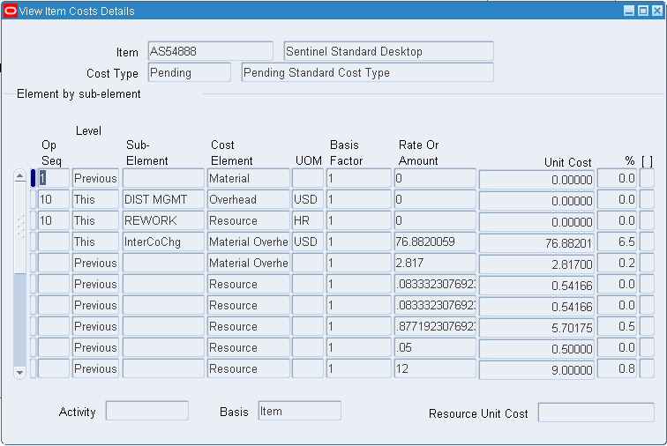
Item Cost Details – Make Item
Menu path: Cost Management => Item Costs => Item Costs => Views Button => Details Button

Slide 65
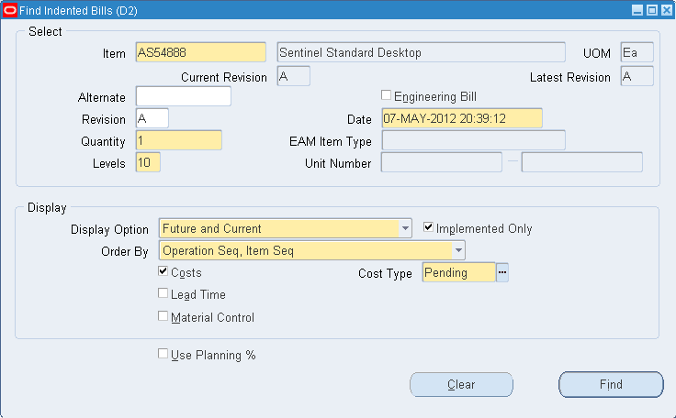
Indented Bill of Material Cost View
Menu path: Cost Management => Item Costs => View Costed Indented Bill of Material
Caution: The Indented BOM Cost View ignores Assignment Sets

Slide 66
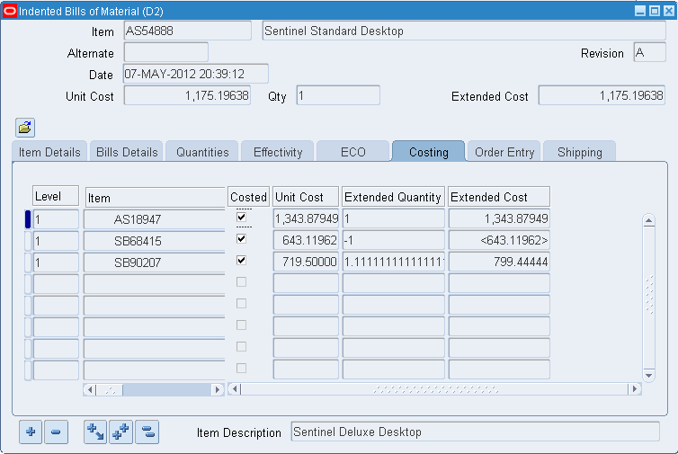
Indented Bill of Material Cost View
Menu path: Cost Management => Item Costs => View Costed Indented Bill of Material
Adds up to 1500.20431 from the BOM example
Missing $200 costs from the Org D2 routing

Slide 67
Cost Rollup Reports
Standard Oracle Reports (Report => Cost => Item)
Cost Type Comparison Report
Detailed Item Cost Report
Elemental Item Cost Report
Item Cost Reports
Supply Chain Indented Bill of Material Cost Report (From a static bill of material, same format)
Supply Chain Consolidated Indented Bill of Material Cost Report (From a static bill of material)

Slide 68
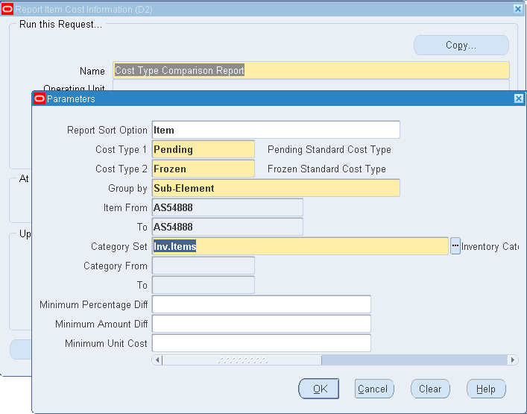
Cost Type Comparison Report
Menu path: Cost Management => Reports => Cost => Item
The new XML reports are not on the Cost Menu
Put the smallest cost type first

Slide 69
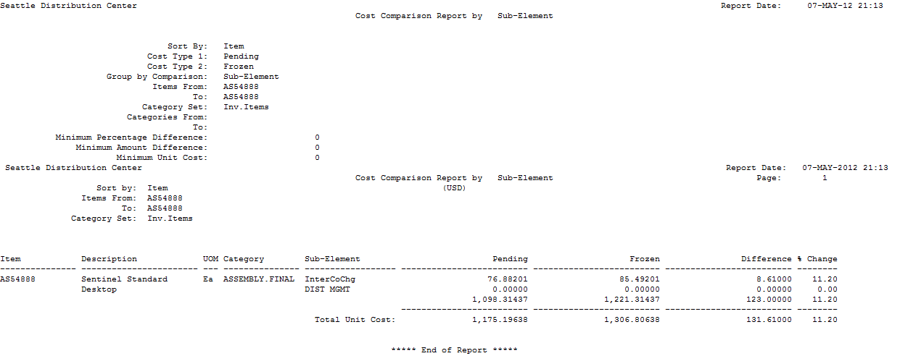
Cost Type Comparison Report
Menu path: Cost Management => Reports => Cost => Item

Slide 70
Cost Type Comparison Report
Menu path: Cost Management => View Requests => Submit a New Request => %Cost Type%
The new XML reports are not on the Cost Menu

Slide 71
Detailed Item Cost Report
Menu path: Cost Management => Reports => Cost => Item

Slide 72
Detailed Item Cost Report
Menu path: Cost Management => Reports => Cost => Item

Slide 73
Elemental Item Cost Report
Menu path: Cost Management => Reports => Cost => Item

Slide 74
Elemental Item Cost Report
Menu path: Cost Management => Reports => Cost => Item

Slide 75
Item Cost Reports
Menu path: Cost Management => Reports => Cost => Item

Slide 76
Item Cost Reports
Menu path: Cost Management => Reports => Cost => Item
If you use Flexfields on your item costs you can report them using the Flexfield Report choices

Slide 77
Item Cost Reports
Menu path: Cost Management => Reports => Cost => Item

Slide 78
Supply Chain Indented Bill of Material Cost Report
Menu path: Cost Management => Reports => Cost => Item
This report uses the existing item cost information with the BOM/routing you choose. It does not do a fresh cost rollup.

Slide 79
Supply Chain Indented Bill of Material Cost Report
Menu path: Cost Management => Reports => Cost => Item

Slide 80
Supply Chain Consolidated Indented Bill of Material Cost Report
Menu path: Cost Management => Reports => Cost => Item

Slide 81
Supply Chain Consolidated Indented Bill of Material Cost Report
Menu path: Cost Management => Reports => Cost => Item
This report combines information across levels

Slide 82
R11i/12 Item Status Controls
Can’t Ship Until Costed

Slide 83
R12 Item Status Controls
Can’t Ship Until Costed
Initial Status: Phase In
Once item is nearly ready, Cost Accounting puts on a cost
Can put on a PO but cannot receive on a PO
Can put on a Sales Order but cannot ship
Cost Accounting has the final say to change the status to: Active
Caution: had to customize the workflow at Emerson, if the status is both Stockable and Transactable, you can still do an initial PO receipt into Receiving Inspection

Slide 84
Item Status Control Enhancements to Consider
Costing Switches Over to Active Status Once Costed

Slide 85
Enhancements to Consider
Cost Rollup Error Checking
Costing Vs. Planning Items Controls Report
Make vs. Buy vs. Sourcing Rule Error Reports
Example from Emerson Power
Revamp the old MRP Audits and make available to Costing
Zero Item Costs Report

Slide 86
Cost Rollup Error Checking Reports ─ Costing Vs. Planning Items Controls Report
Catch the Following Errors
Based on Rollup Yes With Planning Buy But No BOMs or Routings or Sourcing Rules Exist
Based on Rollup Yes With Planning Make But No BOMs or Routings or Sourcing Rules Exist
Based On Rollup Yes With No Cost Rollup Details
Based on Cost Rollup No With Planning Buy But BOMS, Routings or Sourcing Rules Exist
Based on Cost Rollup No but Planning Make But BOMs, Routings or Sourcing Rules Exist
User Defined Costs With Make Items
User Defined and Rolled Up Material Costs

Slide 87
Cost Rollup Error Checking Reports ─ Costing Vs. Planning Items Controls Report
Example from Emerson Power:

Slide 88
Example from Emerson Power (continued)
Use of Descriptive Flexfields on the Item Cost record:

Slide 89
Example from Emerson Power: Sample Output Report

Slide 90
Enhancement: Better Access to MRP Audits
Menu path: Supply Chain Planner => Reports => Audit Information Report
Many Useful for Costing

Slide 91
Enhancement: Better Access to MRP Audits
Menu path: Supply Chain Planner => Reports => Audit Information Report
Many Useful for Costing

Slide 92
Enhancement: Better Access to MRP Audits
Menu path: Supply Chain Planner => Reports => Audit Information Report
Many Useful for Costing

Slide 93
Enhancements to Consider
Cost Rollup Reporting
Better Global Item Cost Reporting
Easy access area (i.e. MS Access or other tools)
Multi-Org Resource Costs Report
Multi-Org Zero Item Costs Report

Slide 94
Cost Rollup Reports ─ Zero Item Costs Report
Custom Zero Item Cost Report
Find your items with no costs
Search by range of creation dates
Identify items with onhand quantities and last transaction date

Slide 95
Summary
Cost Rollup Two Ways
Without assignment sets (within the organization)
With assignment sets (across the supply chain)
Sourcing Rule Setup is Key
Custom Reporting Necessary to Find Data Integrity Errors

Slide 96
Summary
Caveats:
Use of sourcing rules and assignment sets can be confusing
Supply Chain Cost Rollup does not keep sub-element details across organizations
Oracle Forms and Reports do not show the item’s status (Active vs. Inactive)
Need Custom Cost Reports for better visibility
Plan Sufficient Review Time to Catch Errors

Slide 97
Notes:
97

